Slide 1
ElmahR = ELMAH + SignalR
Real time error handling web dashboard
Roberto Vespa
@wasp_twit
http://www.robychechi.it/roby

Slide 2
Agenda
What’s ElmahR?
Session structure
Project structure
Demo + Code
Project status
Wrapping up

Slide 3
What’s ElmahR?
Why ElmahR @ aspConf?
ElmahR is an idea from the real world
  For developers
  For the enterprise too?

Slide 4
Session structure
Project Level: Intermediate
Session Level: Intermediate (full 75 minutes)
  Application architecture
  Live demo stepping through code
  Server side code in C#
  Client side code in Javascript
  Basic knowledge of ELMAH will help
  Quick look at Knockout in action, more details about ELMAH and SignalR

Slide 5
What did I use?
ELMAH
SignalR
Knockout
EF (Code First + Migrations)
RazorEngine
jQuery
Raphael
UnderscoreJs
Twitter bootstrap

Slide 6
ELMAH
Error Logging Modules And Handlers
Extensible framework to trap unhandled exceptions
Can be plugged with no need to write code in your application, just configuration
I extended it writing a new module to POST the details of a just trapped error to a URL

Slide 7
SignalR
Asynchronous signaling library to help build real-time, multi-user interactive web applications
Push data from the server to the client (not just browser clients)
Abstracts the underlying HTTP connection
Keeps it “alive” choosing among several available strategies
Server-side and client-side libraries

Slide 8
Knockout
Javascript library to create responsive UI based on data models (View Model)
Declarative bindings
Great to build Single Page Applications
Great to easily decouple developer’s tasks from web designer’s ones
Helps keeping Javascript code clean and focused on logics, not on DOM manipulation

Slide 9
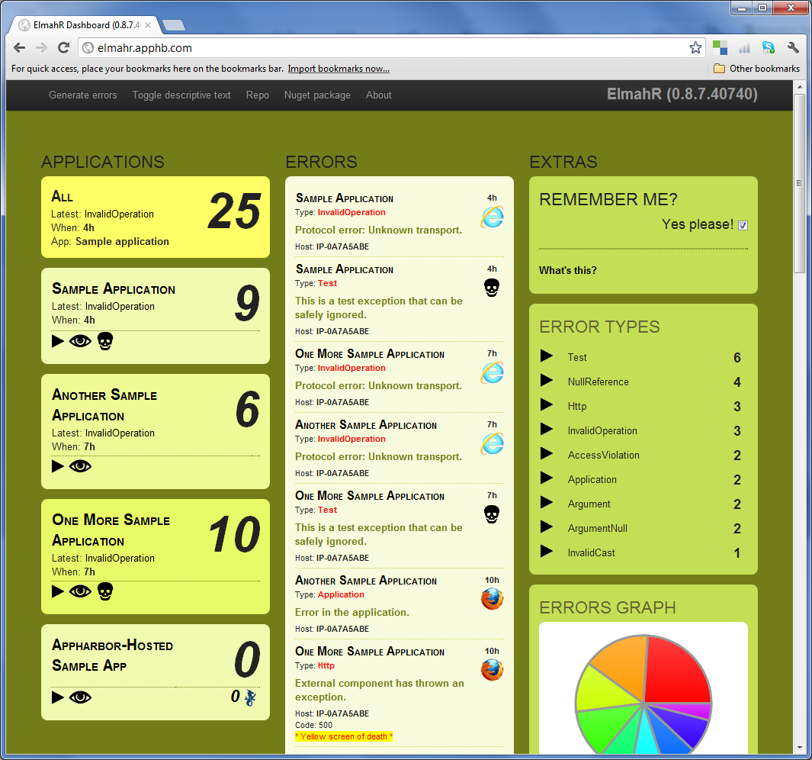
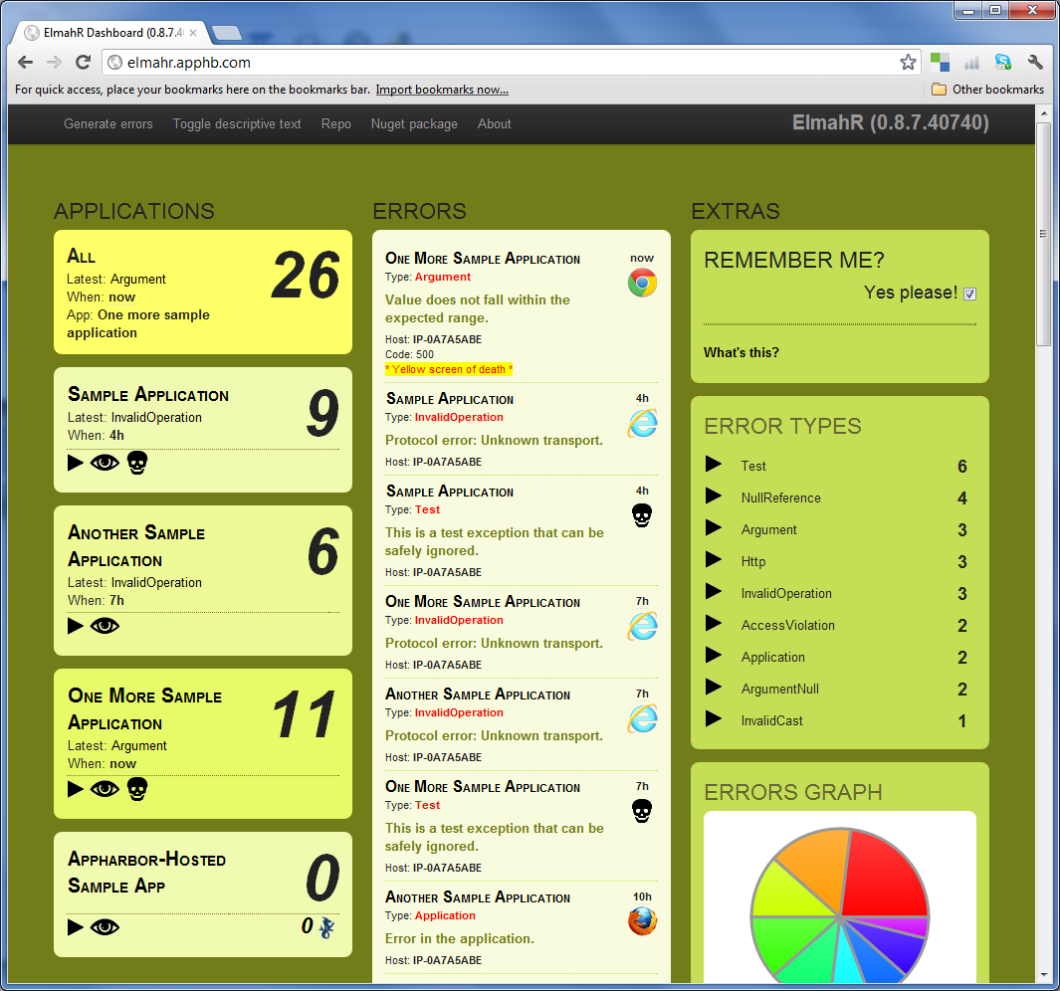


Web apps
ELMAH
ELMAH
ELMAH
ELMAH
ElmahR Module
ElmahR Module
ElmahR Module
ElmahR Module
SignalR
ElmahR

Slide 10
Demo
Quick live demo to give you a full context before digging into the code

Slide 11


SignalR
SignalR
ELMAH
Endpoint
Callbacks
ElmahR Module
SignalR
Knockout
View Models
JSON Error
Collections
HTTP POST
Source App
ElmahR App
Browser

Slide 12
Code
Let’s see the code in action:
  Configuration files
  Starting up ElmahR: SignalR basics
  Exceptions happen: ELMAH modules
  Knockout + MVVM → happy web designer
We’re done!

Slide 13
Project Status
Version 0.8.8
Open source
Contributions are welcome…
…and advices too!
Learning while building
Some portions need improvements
Documentation is very basic

Slide 14
References
ELMAH: http://code.google.com/p/elmah/
SignalR: https://github.com/SignalR/SignalR/
Knockout: http://knockoutjs.com/
Repo: https://bitbucket.org/wasp/elmahr
Demo: http://elmahr.apphb.com/
Blog: http://www.robychechi.it/roby/Tags/elmahr
Nuget: http://nuget.org/packages?q=elmahr

Slide 15
How was it?
My first time as a speaker in a conference ever…
…so I hope I was not too bad ☺
And remember to evaluate this session
Ciao!
Roberto Vespa
@wasp_twit
http://www.robychechi.it/roby

